Slide 1
Word expression
DTS305TC
Huakang Li
Huakang.li@xjtlu.edu.cn
School of AI and Advanced Computing
Notes:
English Title: Uppercase, Calibri size 60, XJTLU Navy
English Subtitle: Uppercase, Calibri size 36, XJTLU Navy

Slide 2
Word2vec
Notes:
English Title: Uppercase, Calibri size 60, XJTLU Navy
English Subtitle: Uppercase, Calibri size 36, XJTLU Navy

Slide 3
TF-IDF
Example
Output
from sklearn.feature_extraction.text import TfidfVectorizer
corpus = [ "The quick brown fox jumps over the lazy dog.",
"The quick brown foxes jump over the lazy dogs and cats.",
"The lazy dogs and cats watch the quick brown foxes jump over the moon."]
tfidf_vectorizer = TfidfVectorizer()
tfidf_matrix = tfidf_vectorizer.fit_transform(corpus)
print(tfidf_matrix.toarray())
[[0. 0. 0. 0.51785612 0. 0. 0. 0. 0. 0. 0.68091856 0.51785612 0. ]
[0. 0. 0. 0.46519584 0. 0. 0.59817854 0. 0. 0. 0. 0.46519584 0.59817854]
[0.33682422 0.33682422 0.33682422 0.30794004 0.33682422 0.33682422 0. 0.33682422 0.33682422 0.33682422 0. 0.30794004 0. ]]

Slide 4
Sparse versus dense vectors
tf-idf (or PMI) vectors are
long (length |V|= 20,000 to 50,000)
sparse (most elements are zero)
Alternative: learn vectors which are
short (length 50-1000)
dense (most elements are non-zero)
Notes:
In the previous lectures we saw how to represent a word as a sparse, long vector with dimensions corresponding to words in the vocabulary or documents in a collection. We now introduce a more powerful word representation: embeddings, short dense vectors. Unlike the vectors we’ve seen so far, embeddings are short, with number of dimensions d ranging from 50-1000, rather than the much larger vocabulary size |V | or number of documents D we’ve seen. These d dimensions don’t have a clear interpretation. And the vectors are dense: instead of vector entries being sparse, mostly-zero counts or functions of counts, the values will be real-valued numbers that can be negative.

Slide 5
Sparse VS dense vectors
Why dense vectors?
Short vectors may be easier to use as features in machine learning (fewer weights to tune)
Dense vectors may generalize better than explicit counts
Dense vectors may do better at capturing synonymy:
car and automobile are synonyms; but are distinct dimensions
a word with car as a neighbor and a word with automobile as a neighbor should be similar, but aren't
In practice, they work better
Notes:
It turns out that dense vectors work better in every NLP task than sparse vectors. While we don’t completely understand all the reasons for this, we have some intu- itions. Representing words as 700-dimensional dense vectors requires our classifiers to learn far fewer weights than if we represented words as 50,000-dimensional vec- tors, and the smaller parameter space possibly helps with generalization and avoid- ing overfitting. Dense vectors may also do a better job of capturing synonymy. For example, in a sparse vector representation, dimensions for synonyms like car and automobile dimension are distinct and unrelated; sparse vectors may thus fail to capture the similarity between a word with car as a neighbor and a word with automobile as a neighbo

Slide 6
Common methods for getting short dense vectors
“Neural Language Model”-inspired models
Word2vec (skipgram, CBOW), GloVe
Singular Value Decomposition (SVD)
A special case of this is called LSA – Latent Semantic Analysis
Alternative to these "static embeddings":
Contextual Embeddings (ELMo, BERT)
Compute distinct embeddings for a word in its context
Separate embeddings for each token of a word
Notes:
In this section we introduce one method for computing embeddings: skip-gram with negative sampling, sometimes called SGNS. The skip-gram algorithm is one of two algorithms in a software package called word2vec, and so sometimes the al- gorithm is loosely referred to as word2vec. The word2vec methods are fast, efficient to train, and easily available online with code and pretrained embeddings. Word2vec embeddings are static embeddings, meaning that the method learns one fixed embedding for each word in the vocabulary. An lternative to these static embeddings are more recent methods for learning dynamic contextual em-beddings like the popular BERT representations, in which the vector for each word is different in different contexts.

Slide 7
Simple static embeddings you can download!
Word2vec (Mikolov et al)
https://code.google.com/archive/p/word2vec/
GloVe (Pennington, Socher, Manning)
http://nlp.stanford.edu/projects/glove/

Slide 8
Word2vec
Popular embedding method
Very fast to train
Code available on the web
Idea: predict rather than count
Word2vec provides various options. We'll do:
Skip-gram with negative sampling (SGNS)

Slide 9
Word2vec
Instead of counting how often each word w occurs near "apricot"
Train a classifier on a binary prediction task:
Is w likely to show up near "apricot"?
We don’t actually care about this task
But we'll take the learned classifier weights as the word embeddings
Big idea: self-supervision:
A word c that occurs near apricot in the corpus cats as the gold "correct answer" for supervised learning
No need for human labels
Bengio et al. (2003); Collobert et al. (2011)
Notes:
The intuition of word2vec is that instead of counting how often each word w oc- curs near, say, apricot, we’ll instead train a classifier on a binary prediction task: “Is word w likely to show up near apricot?” We don’t actually care about this prediction task; instead we’ll take the learned classifier weights as the word embeddings. The revolutionary intuition here is that we can just use running text as implicitly supervised training data for such a classifier; a word c that occurs near the target word apricot acts as gold ‘correct answer’ to the question “Is word c likely to show up near apricot?” This method, often called self-supervision, avoids the need for any sort of hand-labeled supervision signal. This idea was first proposed in the task of neural language modeling, when Bengio et al. (2003) and Collobert et al. (2011) showed that a neural language model (a neural network that learned to predict the next word from prior words) could just use the next word in running text as its supervision signal, and could be used to learn an embedding representation for each word as part of doing this prediction task. word2vec is a much simpler model than the neural network language model, in two ways. First, word2vec simplifies the task (making it binary classification instead of word pre- diction). Second, word2vec simplifies the architecture (training a logistic regression classifier instead of a multi-layer neural network with hidden layers that demand more sophisticated training algorithms)

Slide 10
Approach: predict if candidate word c is a "neighbor"
Treat the target word t and a neighboring context word c as positive examples.
Randomly sample other words in the lexicon to get negative examples
Use logistic regression to train a classifier to distinguish those two cases
Use the learned weights as the embeddings
Notes:
The intuition of skip-gram is:

Slide 11
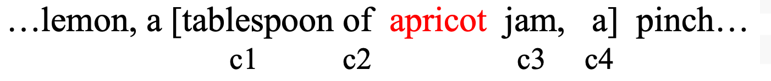
Skip-Gram Training Data
Assume a +/- 2 word window, given training sentence:
[target]
Notes:
Let’s start by thinking about the classification task, and then turn to how to train. Imagine a sentence like the following, with a target word apricot, and assume we’re using a window of ±2 context words:

Slide 12
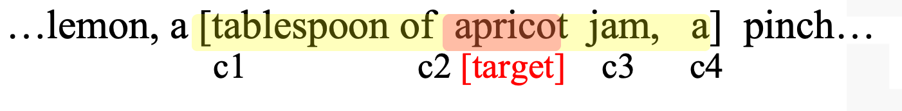
Skip-Gram Classifier
(assuming a +/- 2 word window)
Goal: train a classifier that is given a candidate (word, context) pair
(apricot, jam)
(apricot, aardvark)
And assigns each pair a probability:
P(+|w, c)
P(−|w, c) = 1 − P(+|w, c)
Notes:
Our goal is to train a classifier such that, given a tuple (w,c) of a target word w paired with a candidate context word c (for example (apricot, jam), or perhaps (apricot, aardvark)) it will return the probability that c is a real context word (true for jam, false for aardvark):
The probability that word c is not a real context word for w is just 1 minus

Slide 13
Similarity is computed from dot product
Remember: two vectors are similar if they have a high dot product
Cosine is just a normalized dot product
So:
Similarity(w,c) ∝ w ∙ c
We’ll need to normalize to get a probability
(cosine isn't a probability either)
Notes:
he intuition of the skip- gram model is to base this probability on embedding similarity: a word is likely to occur near the target if its embedding is similar to the target embedding. To compute similarity between these dense embeddings, we rely on the intuition that two vectors are similar if they have a high dot product (after all, cosine is just a normalized dot product). In other words: Similarity(w,c) ∝ w ∙ c

Slide 14
Turning dot products into probabilities
Sim(w,c) ≈ w ∙ c
To turn this into a probability
We'll use the sigmoid from logistic regression:
Notes:
The dot product c · w is not a probability, it’s just a number ranging from −∞ to ∞ (since the elements in word2vec embeddings can be negative, the dot product can be negative). To turn the dot product into a probability, we’ll use the logistic or sigmoid function σ (x) from logistic regression
We model the probability that word c is a real context word for target word w as:
to make it a probability we’ll also need the total probability of the two possible events (c is a context word, and c isn’t a context word) to sum to 1. We thus estimate the probability that word c is not a real context word for w as:

Slide 15
How Skip-Gram Classifier computes P(+|w, c)
This is for one context word, but we have lots of context words.
We'll assume independence and just multiply them:
Notes:
This equation gives us the probability for one word, but there are many context words in the window. Skip-gram makes the simplifying assumption that all context words are independent, allowing us to just multiply their probabilities:

Slide 16
Skip-gram classifier: summary
A probabilistic classifier, given
a test target word w
its context window of L words c_{1:L}
Estimates probability that w occurs in this window based on similarity of w (embeddings) to c_{1:L} (embeddings).
To compute this, we just need embeddings for all the words.
Notes:
In summary, skip-gram trains a probabilistic classifier that, given a test target word w and its context window of L words c1:L, assigns a probability based on how similar this context window is to the target word. The probability is based on applying the logistic (sigmoid) function to the dot product of the embeddings of the target word with each context word. To compute this probability, we just need embeddings for each target word and context word in the vocabulary.

Slide 17
These embeddings we'll need: a set for w, a set for c
w
Notes:
Here's the intuition of parameters we’ll need. Skip-gram actually stores two embeddings for each word, one for the word as a target, and one for the word considered as context. Thus the parameters we need to learn are two matrices W and C, each containing an embedding for every one of the |V | words in the vocbulary

Slide 18
Word2vec: Learning the embeddings
Notes:
English Title: Uppercase, Calibri size 60, XJTLU Navy
English Subtitle: Uppercase, Calibri size 36, XJTLU Navy

Slide 19
Skip-Gram Training data
Notes:
Skip-gram learns embeddings by starting with random embedding vectors and then iteratively shifting the embedding of each word w to be more like the embeddings of words that occur nearby in texts, and less like the embeddings of words that don’t occur nearby. Let’s start by considering a single piece of training data
This example has a target word w (apricot), and 4 context words in the L = ±2 window, resulting in 4 positive training instances (on the left below):

Slide 20
Skip-Gram Training data
For each positive example we'll grab k negative examples, sampling by frequency
Notes:
For training a binary classifier we also need negative examples. In fact skip- gram with negative sampling (SGNS) uses more negative examples than positive examples (with the ratio between them set by a parameter k). So for each of these (w,cpos) training instances we’ll create k negative samples, each consisting of the target w plus a ‘noise word’ cneg. A noise word is a random word from the lexicon, constrained not to be the target word w.

Slide 21
Skip-Gram Training data
Notes:
Here's the setting where k = 2, so we’ll have 2 negative examples in the negative training set − for each positive example w,cpos. The noise words are chosen according to their weighted unigram frequency.

Slide 22
Word2vec: how to learn vectors
Given the set of positive and negative training instances, and an initial set of embedding vectors
The goal of learning is to adjust those word vectors such that we:
Maximize the similarity of the target word, context word pairs (w , c_{pos}) drawn from the positive data
Minimize the similarity of the (w , c_{neg}) pairs drawn from the negative data.
Notes:
Given the set of positive and negative training instances, and an initial set of embeddings, the goal of the learning algorithm is to adjust those embeddings to
• Maximize the similarity of the target word, context word pairs (w,cpos) drawn from the positive examples
• Minimize the similarity of the (w,cneg) pairs from the negative examples.

Slide 23
Loss function for one w with c_{pos} , c_{neg1} ...c_{negk}
Maximize the similarity of the target with the actual context words, and minimize the similarity of the target with the k negative sampled non-neighbor words.
Notes:
If we consider one word/context pair (w, cpos ) with its k noise words cneg1 ...cnegk , our goal is to maximize the similarity of the target with the actual context words, andn minimize the similarity of the target with the k negative sampled non-neighbor words. We can express these two goals as the following loss function L to be minimized (hence the −); here the first term expresses that we want the classifier to assign the real context word cpos a high probability of being a neighbor, and the second term expresses that we want to assign each of the noise words cnegi a high probability of being a non-neighbor, all multiplied because we assume independence:
If we substitute in our sigmoid of the dot product estimate for P, we want to maximize the dot product of the word with the actual context words, and minimize the dot products of the word with the k negative sampled non- neighbor words.
􏰼

Slide 24
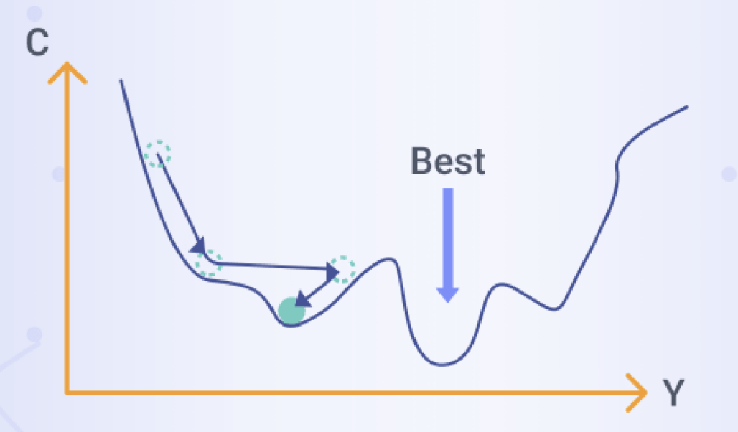
Learning the classifier
How to learn?
Stochastic gradient descent!
We’ll adjust the word weights to
make the positive pairs more likely
and the negative pairs less likely,
over the entire training set.
https://www.xenonstack.com/glossary/stochastic-gradient-descent
Notes:
We minimize this loss function using stochastic gradient descent.

Slide 25
Intuition of one step of gradient descent
Notes:
Let's look at the intuition of one step of gradient descent. The skip-gram model tries to shift embeddings so the target embeddings (here for apricot) are closer to (have a higher dot product with) context embeddings for nearby words (here jam) and further from (lower dot product with) context embeddings for noise words that don’t occur nearby (here Tolstoy and matrix).

Slide 26
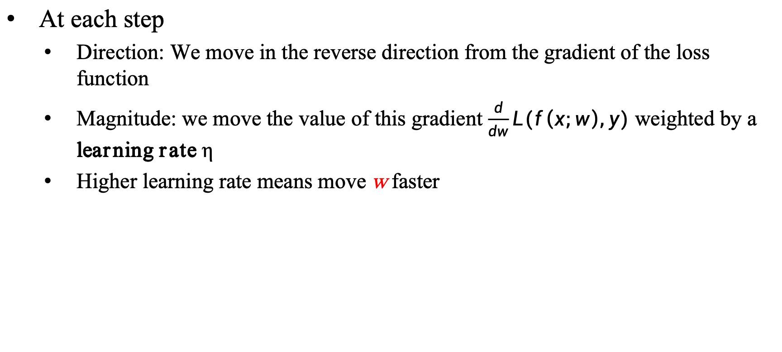
Reminder: gradient descent
At each step
Direction: We move in the reverse direction from the gradient of the loss function
Magnitude: we move the value of this gradient $\frac{d}{dw}L(f\left(x;w\right),y)$ weighted by a learning rate η
Higher learning rate means move w faster

Slide 27
The derivatives of the loss function
Notes:
To get the gradient, we need to take the derivative of this equation with respect to the different embeddings. We'll need a derivate for the C embeddings and for the W embeddings. And we'll want a different derivative for the weights for the positive context examples and the nevative context examples, since we want to move them in opposite directions. It turns out the derivatives are the following elegant functions.

Slide 28
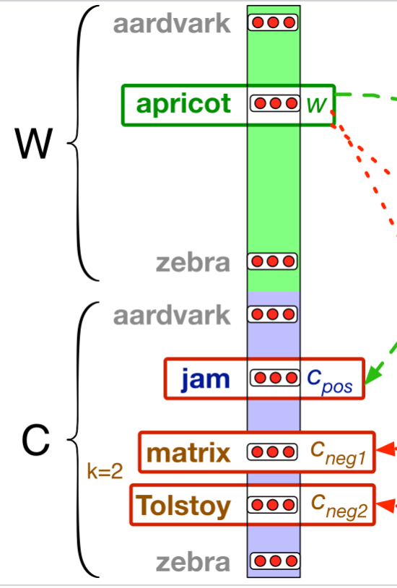
Update equation in SGD
Start with randomly initialized C and W matrices, then incrementally do updates
Notes:
The update equations going from time step t to t + 1 in stochastic gradient descent are thus:
Just as in logistic regression, then, the learning algorithm starts with randomly initialized W and C matrices, and then walks through the training corpus using gradient descent to move W and C so as to maximize the objective we saw earlier by making the updates here.

Slide 29
Two sets of embeddings
SGNS learns two sets of embeddings
Target embeddings matrix W
Context embedding matrix C
It's common to just add them together, representing i-th word as the vector w_{i} + c_{i}
Notes:
As we've just seen, the skip-gram model learns two separate embeddings for each word i: the target embedding w and the context embedding c , stored in two matrices, the target matrix W and the context matrix C. Ibut if we just need one vector to represent a word, what should we use? t’s common to just add them together, representing word i with the vector wi + ci .

Slide 30
Summary: How to learn word2vec (skip-gram) embeddings
Start with V random d-dimensional vectors as initial embeddings
Train a classifier based on embedding similarity
Take a corpus and take pairs of words that co-occur as positive examples
Take pairs of words that don't co-occur as negative examples
Train the classifier to distinguish these by slowly adjusting all the embeddings to improve the classifier performance
Throw away the classifier code and keep the embeddings.

Slide 31
Properties of Embeddings
Notes:
English Title: Uppercase, Calibri size 60, XJTLU Navy
English Subtitle: Uppercase, Calibri size 36, XJTLU Navy

Slide 32
The kinds of neighbors depend on window size
Small windows (C= +/- 2) : nearest words are syntactically similar words in same taxonomy
Hogwarts nearest neighbors are other fictional schools
Sunnydale, Evernight, Blandings
Large windows (C= +/- 5) : nearest words are related words in same semantic field
Hogwarts nearest neighbors are Harry Potter world:
Dumbledore, half-blood, Malfoy
Notes:
One parameter of vector semantic models that is relevant to both sparse tf-idf vectors and dense word2vec vectors is the size of the context window used to collect counts. This is generally between 1 and 10 words on each side of the target word (for a total context of 2-20 words).
The choice depends on the goals of the representation. Shorter context windows tend to lead to representations that are a bit more syntactic, since the information is coming from immediately nearby words. When the vectors are computed from short context windows, the most similar words to a target word w tend to be semantically similar words with the same parts of speech. When vectors are computed from long context windows, the highest cosine words to a target word w tend to be words that are topically related but not similar. For example Levy and Goldberg (2014a) showed that using skip-gram with a window of ±2, the most similar words to the word Hogwarts (from the Harry Potter series) were names of other fictional schools: Sunnydale (from Buffy the Vampire Slayer) or Evernight (from a vampire series). With a window of ±5, the most similar words to Hogwarts were other words topically related to the Harry Potter series: Dumbledore, Malfoy, and half-blood.

Slide 33
Analogical relations
The classic parallelogram model of analogical reasoning (Rumelhart and Abrahamson 1973)
To solve: "apple is to tree as grape is to _____"
Add tree – apple to grape to get vine
Notes:
Another semantic property of embeddings is their ability to capture relational meanings. In an important early vector space model of cognition, Rumelhart and Abrahamson (1973) proposed the parallelogram model for solving simple analogy problems of the form a is to b as a* is to what?. In such problems, a system given a problem like apple:tree::grape:?, i.e., apple is to tree as grape is to , and must fill in the word vine.
In the parallelogram model, the vector from the word apple ito the word tree (= apple − tree)
is added to the vector for grape (grape); the nearest word to that point is returned

Slide 34
Analogical relations via parallelogram
The parallelogram method can solve analogies with both sparse and dense embeddings (Turney and Littman 2005, Mikolov et al. 2013b)
king – man + woman is close to queen
Paris – France + Italy is close to Rome
For a problem a:a*::b:b*, the parallelogram method is:
Notes:
For a a:b::a*:b* problem, meaning the algorithm is given a, b, and a* and must find b*, the parallelogram method is thus: EQUATION
with the distance function defined either as cosine or as Euclidean distance.

Slide 35
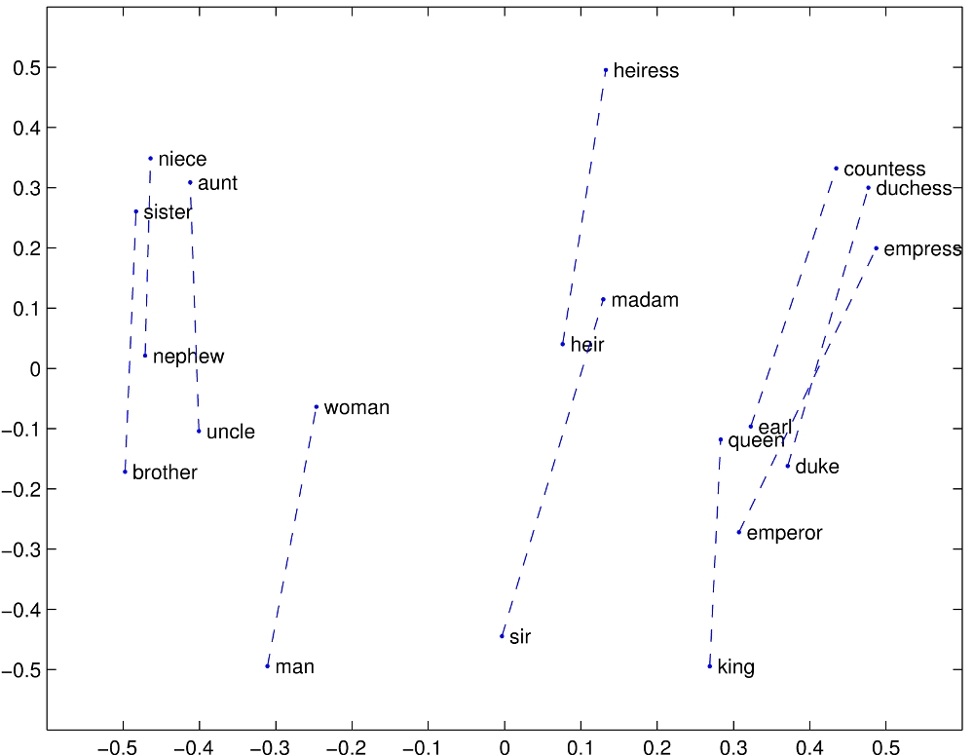
Structure in GloVE Embedding space

Slide 36
Caveats with the parallelogram method
It only seems to work for frequent words, small distances and certain relations (relating countries to capitals, or parts of speech), but not others. (Linzen 2016, Gladkova et al. 2016, Ethayarajh et al. 2019a)
Understanding analogy is an open area of research (Peterson et al. 2020)

Slide 37
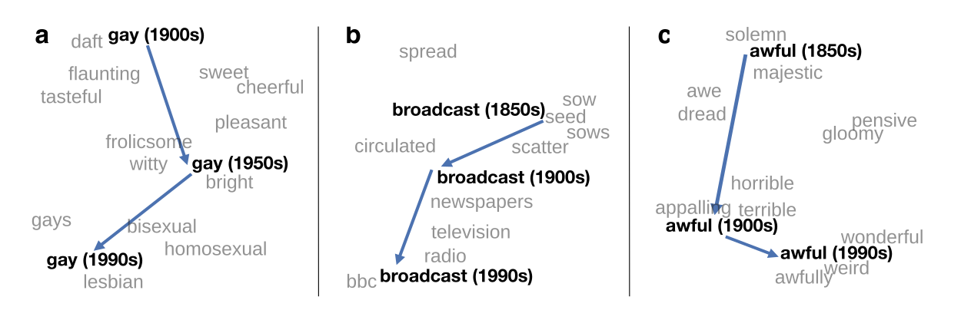
Embeddings as a window onto historical semantics
Train embeddings on different decades of historical text to see meanings shift
~30 million books, 1850-1990, Google Books data
William L. Hamilton, Jure Leskovec, and Dan Jurafsky. 2016. Diachronic Word Embeddings Reveal Statistical Laws of Semantic Change. Proceedings of ACL.
Notes:
Embeddings can also be a useful tool for studying how meaning changes over time, by computing multiple embedding spaces, each from texts written in a particular time period. For example these figures shows a visualization of changes in meaning in English words over the last two centuries, computed by building separate embedding spaces for each decade from historical corpora like Google N-grams and the Corpus of Historical American English.

Slide 38
Embeddings reflect cultural bias!
Ask “Paris : France :: Tokyo : x”
x = Japan
Ask “father : doctor :: mother : x”
x = nurse
Ask “man : computer programmer :: woman : x”
x = homemaker
Algorithms that use embeddings as part of e.g., hiring searches for programmers, might lead to bias in hiring
Bolukbasi, Tolga, Kai-Wei Chang, James Y. Zou, Venkatesh Saligrama, and Adam T. Kalai. "Man is to computer programmer as woman is to homemaker? debiasing word embeddings." In NeurIPS, pp. 4349-4357. 2016.
Notes:
In addition to their ability to learn word meaning from text, embeddings, alas, also reproduce the implicit biases and stereotypes that were latent in the text. As the prior section just showed, embeddings can roughly model relational similar- ity: ‘queen’ as the closest word to ‘king’ - ‘man’ + ‘woman’ implies the analogy man:woman::king:queen. But these same embedding analogies also exhibit gender stereotypes. For example the embeddings suggest the analogy ‘father’ is to ‘doctor’ as ‘mother’ is to ‘nurse’, and the closest occupation to ‘man’ - ‘computer programmer’ + ‘woman’ in word2vec embeddings trained on news text is ‘homemaker'
This could result in what Crawford calls an allocational harm, when a system allo- cates resources (jobs or credit) unfairly to different groups. For example algorithms that use embeddings as part of a search for hiring potential programmers or doctors might thus incorrectly downweight documents with women’s names.

Slide 39
Historical embedding as a tool to study cultural biases
Compute a gender or ethnic bias for each adjective: e.g., how much closer the adjective is to "woman" synonyms than "man" synonyms, or names of particular ethnicities
Embeddings for competence adjective (smart, wise, brilliant, resourceful, thoughtful, logical) are biased toward men, a bias slowly decreasing 1960-1990
Embeddings for dehumanizing adjectives (barbaric, monstrous, bizarre) were biased toward Asians in the 1930s, bias decreasing over the 20th century.
These match the results of old surveys done in the 1930s
Garg, N., Schiebinger, L., Jurafsky, D., and Zou, J. (2018). Word embeddings quantify 100 years of gender and ethnic stereotypes. Proceedings of the National Academy of Sciences 115(16), E3635–E3644.
Notes:
Historical embeddings are also being used to measure biases in the past. Garg et al. (2018) used embeddings from historical texts to measure the association be- tween embeddings for adjectives and embeddings for names of various ethnici- ties or genders. embeddings for adjectives related to competence (‘smart’, ‘wise’, ‘thoughtful’, ‘resourceful’) had a higher cosine with male than fe- male words, and showed that this bias has been slowly decreasing since 1960, and that Historical embeddings also repli- cated old surveys of ethnic stereotypes; Embeddings for Chinese names were biased twoare dehumanizing adjectives like ‘barbaric’ in the 1930s, matching the results of old surveys done in the 1930s, but this bias decreased in both text and surveys over the 20th century.

Slide 40
Part of Speech Tagging
Notes:
English Title: Uppercase, Calibri size 60, XJTLU Navy
English Subtitle: Uppercase, Calibri size 36, XJTLU Navy

Slide 41
Parts of Speech
From the earliest linguistic traditions (Yaska and Panini 5th C. BCE, Aristotle 4th C. BCE), the idea that words can be classified into grammatical categories
part of speech, word classes, POS, POS tags
8 parts of speech attributed to Dionysius Thrax of Alexandria (c. 1st C. BCE):
noun, verb, pronoun, preposition, adverb, conjunction, participle, article
These categories are relevant for NLP today.
Notes:
From the earliest linguistic traditions (the Sanskrit grammarians Yaska and Panini in India, the Aristotle and the Stoics in Greece), came idea that words can be classified into grammatical categories, what we now call parts of speech, word classes, or sometimes just for short, POS or POS tags.
By 100 BCE, Dionysius Thrax settled on a set of eight that became the basis for descriptions of European languages for the next 2000 years.
The durability of parts of speech through two millennia speaks to their centrality in models of human language.

Slide 42
Two classes of words: Open vs. Closed
Closed class words
Relatively fixed membership
Usually function words: short, frequent words with grammatical function
determiners: a, an, the
pronouns: she, he, I
prepositions: on, under, over, near, by, …
Open class words
Usually content words: Nouns, Verbs, Adjectives, Adverbs
Plus interjections: oh, ouch, uh-huh, yes, hello
New nouns and verbs like iPhone or to fax
Notes:
Let's talk about some parts of speech. While these word classes do have semantic tendencies—adjectives, for example, often describe properties and nouns people— parts of speech are defined instead based on their grammatical relationship with neighboring words or the morphological properties about their affixes.
Parts of speech fall into two broad categories: closed class and open class. Closed classes are those with relatively fixed membership, such as prepositions— new prepositions are rarely coined. By contrast, nouns and verbs are open classes— new nouns and verbs like iPhone or to fax are continually being created or borrowed. Closed class words are generally function words like of, it, and, or you, which tend to be very short, occur frequently, and often have structuring uses in grammar.
Four major open classes occur in the languages of the world: nouns (including proper nouns), verbs, adjectives, and adverbs, as well as the smaller open class of interjections. English has all five, although not every language does.

Slide 43
Open class ("content") words
Nouns
Verbs
Adjectives
old green tasty
Proper
Common
Main
Adverbs
slowly yesterday
Janet
Italy
cat, cats
mango
eat
went
Interjections
Ow hello
Numbers
… more
122,312
one
Closed class ("function")
Auxiliary
Determiners
the some
can
had
Prepositions
to with
Conjunctions
and or
Particles
off up
… more
Pronouns
they its
Notes:
Nouns are words for people, places, or things, but include others as well. Common nouns include concrete terms like cat and mango, abstractions like algorithm and beauty, and verb-like terms like pacing as in His pacing to and fro became quite annoying.
Verbs refer to actions and processes, including open-class main verbs like draw, provide, and go. and closed-class auxiliary verbs like "can", "will", "had" Auxiliary verbs can mark semantic features of a main verb such as its tense, aspect, or made.
Adjectives often describe properties or qualities of nouns, like color (white, black), age (old, young), and value (good, bad)
Other closed class or function words include Pronouns act as a shorthand for referring to an entity or event, or
conjunctions that join two phrases, clauses, or sentences, including Coordinating conjunc- tions like and, or, and but, or subordinating conjunctions like that in “I thought that you might like some milk” that links "the verb thought" with the clause "you might like some milk".

Slide 44
Part-of-Speech Tagging
Assigning a part-of-speech to each word in a text.
Words often have more than one POS.
book:
VERB: (Book that flight)
NOUN: (Hand me that book).
Notes:
Part-of-speech tagging is the process of assigning a part-of-speech to each word in a text.
Tagging is a disambiguation task; words are ambiguous —have more than one possible part-of-speech—and the goal is to find the correct tag for the situation.
For example, book can be a verb (book that flight) or a noun (hand me that book).

Slide 45
Part-of-Speech Tagging
Map from sequence x₁,…,x_{n} of words to y₁,…,y_{n} of POS tags
Notes:
Here's a sketch of part of speech tagging. The input is a sequence x1,x2,...,xn of (tokenized) words and a tagset, and the output is a sequence y1,y2,...,yn of tags, each output yi corresponding exactly to one input xi,

Slide 46
"Universal Dependencies" Tagset
Nivre et al. 2016

Slide 47
Sample "Tagged" English sentences
There/PRO were/VERB 70/NUM children/NOUN there/ADV ./PUNC
Preliminary/ADJ findings/NOUN were/AUX reported/VERB in/ADP today/NOUN ’s/PART New/PROPN England/PROPN Journal/PROPN of/ADP Medicine/PROPN
Notes:
Here are some sample tagged sentences. Notice that we have to make decisions about segmentation (punctuation, or the English 's is often segmented off as a particular), and the same word can have different tags in different sentences.

Slide 48
Why Part of Speech Tagging?
Can be useful for other NLP tasks
Parsing: POS tagging can improve syntactic parsing
MT: reordering of adjectives and nouns (say from Spanish to English)
Sentiment or affective tasks: may want to distinguish adjectives or other POS
Text-to-speech (how do we pronounce “lead” or "object"?)
Or linguistic or language-analytic computational tasks
Need to control for POS when studying linguistic change like creation of new words, or meaning shift
Or control for POS in measuring meaning similarity or difference
Notes:
Part of speech tagging is useful for NLP tasks, most notably for parsing, where it has long played a part, but also for machine translation, sentiment, or even text-to-speech systems. For example "lead" is pronounced "lead" when it is a noun, but "lead" when it is a verb, or "object" is pronounced OBject when it is a noun, but object when it is a verb.
Tagging is also important for linguistic or language-analytic computational tasks, like studying the creation of new words, or measuring meaning similarity or difference.

Slide 49
How difficult is POS tagging in English?
Roughly 15% of word types are ambiguous
Hence 85% of word types are unambiguous
Janet is always PROPN, hesitantly is always ADV
But those 15% tend to be very common.
So ~60% of word tokens are ambiguous
E.g., back
earnings growth took a back/ADJ seat
a small building in the back/NOUN
a clear majority of senators back/VERB the bill
enable the country to buy back/PART debt
I was twenty-one back/ADV then
Notes:
How hard is POS tagging. In English, only 15% of word types are ambiguous. So 85% of words don't need any disambiguating; Janet is always a proper noun, hesitantly is always an adverb.
But those 15% ambiguous words tend to be common words, and so they occur far more than 15% of the time; indeed around 60% of word tokens in running text are ambiguous. So for example the word "back" can have one of 5 part of speech tags.

Slide 50
How difficult is POS tagging in Chinese?
POS tagging (Part-of-Speech tagging) in Chinese poses a number of challenges that make it more difficult than in languages like English. Here are some key factors that contribute to the difficulty of Chinese POS tagging:
Lack of Morphological Inflections:
Chinese, unlike languages like English, lacks morphological inflections that can provide strong clues for POS tags. In English, word endings such as "-s" for plurals or "-ed" for past tense verbs can significantly help in determining a word's part of speech. However, Chinese words do not undergo such morphological changes, making it more difficult to identify their parts of speech based solely on their form.
Ambiguity and Polysemy:
Many Chinese words are ambiguous and can function as multiple parts of speech depending on the context. For example, the word "发展" can be used as a noun (development) or a verb (to develop). This requires the POS tagger to rely heavily on the context and syntactic information rather than just the word itself.
Notes:
How hard is POS tagging. In English, only 15% of word types are ambiguous. So 85% of words don't need any disambiguating; Janet is always a proper noun, hesitantly is always an adverb.
But those 15% ambiguous words tend to be common words, and so they occur far more than 15% of the time; indeed around 60% of word tokens in running text are ambiguous. So for example the word "back" can have one of 5 part of speech tags.

Slide 51
How difficult is POS tagging in Chinese?
Training Corpus Quality and Quantity:
The availability of high-quality and large-scale annotated training corpora for Chinese POS tagging is limited. While some resources like the People's Daily corpus exist, they may not be sufficient to cover the full range of linguistic phenomena in Chinese. Additionally, the annotation quality can vary, which can affect the performance of the POS tagger.
Different Annotation Standards:
There is no universally agreed-upon POS tagging standard for Chinese, and different researchers and organizations may use different tagging schemes and sets of tags. This can make it difficult to compare and evaluate different POS tagging systems.
Notes:
How hard is POS tagging. In English, only 15% of word types are ambiguous. So 85% of words don't need any disambiguating; Janet is always a proper noun, hesitantly is always an adverb.
But those 15% ambiguous words tend to be common words, and so they occur far more than 15% of the time; indeed around 60% of word tokens in running text are ambiguous. So for example the word "back" can have one of 5 part of speech tags.

Slide 52
How difficult is POS tagging in Chinese?
One-Character Words:
Chinese includes a large number of one-character words that can be difficult to tag correctly. These words often have multiple meanings and can function as different parts of speech depending on the context.
Syntactic and Semantic Complexity:
Chinese sentences can be syntactically and semantically complex, with long-distance dependencies and non-linear word orders. This requires the POS tagger to have a deep understanding of the linguistic structure of Chinese sentences in order to accurately assign tags.
Notes:
How hard is POS tagging. In English, only 15% of word types are ambiguous. So 85% of words don't need any disambiguating; Janet is always a proper noun, hesitantly is always an adverb.
But those 15% ambiguous words tend to be common words, and so they occur far more than 15% of the time; indeed around 60% of word tokens in running text are ambiguous. So for example the word "back" can have one of 5 part of speech tags.

Slide 53
POS tagging performance in English
How many tags are correct? (Tag accuracy)
About 97%
Hasn't changed in the last 10+ years
HMMs, CRFs, BERT perform similarly .
Human accuracy about the same
But baseline is 92%!
Baseline is performance of stupidest possible method
"Most frequent class baseline" is an important baseline for many tasks
Tag every word with its most frequent tag
(and tag unknown words as nouns)
Partly easy because
Many words are unambiguous
Notes:
How accurate are modern POS taggers? Quite accurate; for English, and a for a few other languages wwhere we have sufficient hand-labeled training data, and which have sufficiently simple morphology, tagging is a mostly solved problem.
The accuracy, that is, the percemtage of tokens that the tagger assigns the correct tag to, is about 97%
Of course, for English, the baseline itself is quite high. What's called the most frequent class baesline is simply to tag every word with its most frequent tag. For unknown words, tag them as nouns. This baseline gets around 92% accuracy, simply because, as we've seen, many words are not ambiguous.

Slide 54
POS tagging performance in Chinese
The performance of POS tagging (Part-of-Speech tagging) in Chinese has been improving steadily over the years, but it still faces challenges due to the unique linguistic characteristics of the language. Here are some key points about the current state of POS tagging performance in Chinese:
Advancements in Algorithms and Techniques:
Recent years have seen significant advancements in algorithms and techniques used for Chinese POS tagging. Deep learning models, such as neural networks, have become increasingly popular and have shown promising results in improving the accuracy of POS tagging in Chinese.
Joint Modeling with Other NLP Tasks:
Researchers have found that joint modeling of POS tagging with other natural language processing (NLP) tasks, such as dependency parsing, can help improve the performance of both tasks. This is because the two tasks share information and can benefit from each other's outputs.
Notes:
How accurate are modern POS taggers? Quite accurate; for English, and a for a few other languages wwhere we have sufficient hand-labeled training data, and which have sufficiently simple morphology, tagging is a mostly solved problem.
The accuracy, that is, the percemtage of tokens that the tagger assigns the correct tag to, is about 97%
Of course, for English, the baseline itself is quite high. What's called the most frequent class baesline is simply to tag every word with its most frequent tag. For unknown words, tag them as nouns. This baseline gets around 92% accuracy, simply because, as we've seen, many words are not ambiguous.

Slide 55
POS tagging performance in Chinese
Availability of Training Data:
The availability of large-scale annotated training data for Chinese POS tagging has increased, which has helped improve the performance of POS taggers. However, the quality and diversity of the training data can still affect the performance of the models.
Challenges Remain:
Despite these advancements, Chinese POS tagging still faces challenges due to the language's unique characteristics, such as the lack of morphological inflections, ambiguity and polysemy of words, and syntactic and semantic complexity. These factors make it difficult for POS taggers to achieve perfect accuracy.
Performance Metrics:
The performance of Chinese POS taggers is typically evaluated using metrics such as accuracy, precision, recall, and F1 score. The specific values of these metrics can vary depending on the dataset, tagging scheme, and model used.
State-of-the-Art Performance:
The state-of-the-art performance of Chinese POS tagging systems continues to improve as researchers develop new algorithms and techniques. However, it is difficult to provide a specific number for the current state-of-the-art performance as it can vary depending on the evaluation criteria and datasets used.
Notes:
How accurate are modern POS taggers? Quite accurate; for English, and a for a few other languages wwhere we have sufficient hand-labeled training data, and which have sufficiently simple morphology, tagging is a mostly solved problem.
The accuracy, that is, the percemtage of tokens that the tagger assigns the correct tag to, is about 97%
Of course, for English, the baseline itself is quite high. What's called the most frequent class baesline is simply to tag every word with its most frequent tag. For unknown words, tag them as nouns. This baseline gets around 92% accuracy, simply because, as we've seen, many words are not ambiguous.

Slide 56
Sources of information for POS tagging
Janet will back the bill
AUX/NOUN/VERB? NOUN/VERB?
Prior probabilities of word/tag
"will" is usually an AUX
Identity of neighboring words
"the" means the next word is probably not a verb
Morphology and wordshape:
Prefixes unable: un- → ADJ
Suffixes importantly: -ly → ADJ
Capitalization Janet: CAP → PROPN
Notes:
Part of speech taggers generally make use of three sources of information: let's consider disambiguating the words in the sentence "Janet will back the bill".
One source is the prior probability of the word having that tag; so the word "will" is usually an AUX, less frequently a Noun (like someone "of strong will") or VERB. Another source is the neighboring words. "the" usually precedes adjectives and nouns, not verbs. And the final is the makeup of the word itself; the prefex "un" often indicates an adjective, the suffix "ly" almost always an adverb, and capitalization is a strong hint word proper nouns.

Slide 57
Standard algorithms for POS tagging
Supervised Machine Learning Algorithms:
Hidden Markov Models
Conditional Random Fields (CRF)/ Maximum Entropy Markov Models (MEMM)
Neural sequence models (RNNs or Transformers)
Large Language Models (like BERT), finetuned
All required a hand-labeled training set, all about equal performance (97% on English)
All make use of information sources we discussed
Via human created features: HMMs and CRFs
Via representation learning: Neural LMs
Notes:
POS tagging can be done with classic supervised machine learning algorithms like Hidden Markov Models or Conditional Random Fields, or with neural models, either neural sequence models trained from scratch, or large language models, finetuned.
For English, with sufficient training data, all achieve about equal performance.
And all make use of the information sources we discussed; HMMs and CRFs via human-created features, and the neural models by inducing these features via representation learning.

Slide 58

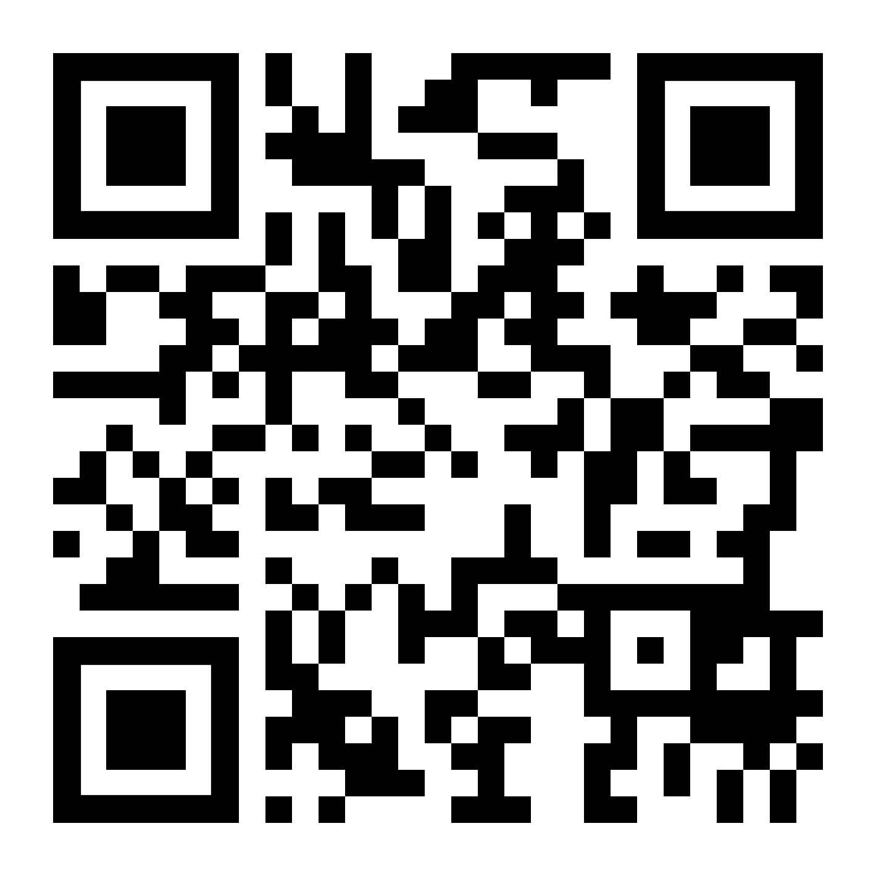

THANK YOU
Visit us
FOLLOW us
www.xjtlu.edu.cn
Notes:
Title: Uppercase, Calibri size 60, XJTLU Navy

